Slide 1
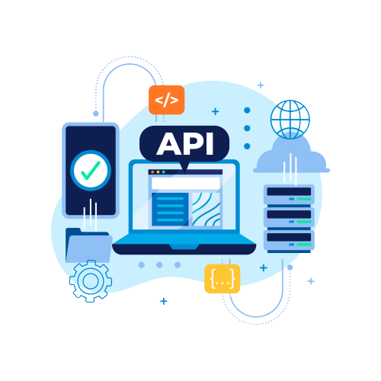
Web APIs
Notes:
I’m excited to present this slide on the topic of ASP.NET Core Web APIs. As we delve into this essential aspect of modern web development, let’s take a moment to understand the core concepts illustrated in this topic.

Slide 2
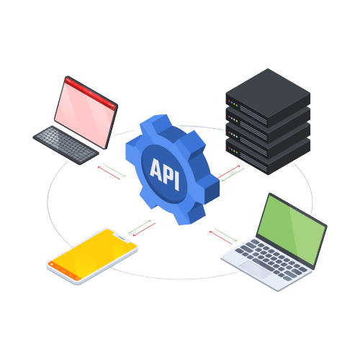

Introduction to Web APIs
Web APIs are a type of web service that allows client applications to access data and functionality on a server.
They are becoming increasingly popular in modern web development, as they allow developers to build more modular and scalable applications.
Notes:
Introduction to Web APIs
provides a succinct yet comprehensive overview of what Web APIs are and their growing significance in today’s digital landscape. Web APIs, as highlighted here, are a type of web service that empowers client applications by granting them access to data and functionality on a server. This interoperability is the cornerstone that enables seamless interactions between diverse systems and platforms.
In the visual representation on the right, you can observe various client devices - including laptops and mobile phones - interconnected through an API. This illustration underscores the API’s role as a central hub facilitating communication among different client applications, each represented by these devices.
Web APIs are not just technical constructs but are becoming increasingly popular in modern web development. The reason? They allow developers to build more modular and scalable applications. In an era where adaptability and scalability are paramount, Web APIs stand as pivotal elements ensuring that applications can grow, evolve, and adapt to meet emerging challenges.

Slide 3

Web APIs can be used to perform a variety of tasks, such as:
Retrieving data
Sending data
Exchanging messages
Notes:
Web APIs can be used to perform a variety of tasks, such as:
Retrieving data
sending data
Exchanging messages

Slide 4
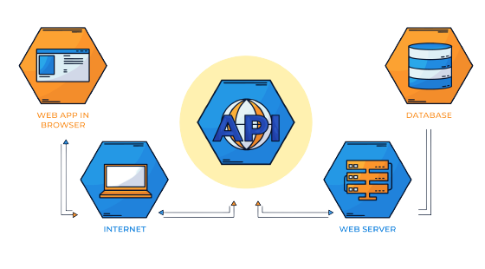
What are the benefits of using Web APIs?
Modularization
Scalability
Reusability
Notes:
In this slide, we explore the significant benefits of using Web APIs. As illustrated, Web APIs play a pivotal role in enhancing Modularization, Scalability, and Reusability.
Modularization refers to breaking down a complex system into smaller, independent components (modules).
Scalability is the ability of a system to handle increased load or demand without compromising performance.
Reusability refers to using existing components or code in multiple contexts.

Slide 5

RESTful API
RESTful APIs are a type of API that follows the REST architectural style.
REST stands for Representational State Transfer, and it is a set of design principles that define how web services should be built.
Notes:
RESTful API
As depicted in this slide, RESTful APIs are not just a technical term but a bridge that connects various applications and services, making our digital experiences seamless and integrated.
REST stands for Representational State Transfer. It is more than an acronym; it is a set of design principles that define how web services should be built to ensure performance, scalability, simplicity, modifiability, visibility, portability, and reliability.
As you can see on the screen, we have illustrated a scenario where job data is being processed. This is not just an illustration but a representation of how RESTful APIs integrate different data sources and services to deliver real-time information efficiently.
In essence, RESTful APIs are the unsung heroes behind the scenes that power the dynamic and interactive web applications we interact with daily. They ensure that data is transferred in a state that can be processed easily - making them an integral part of modern web architecture.

Slide 6
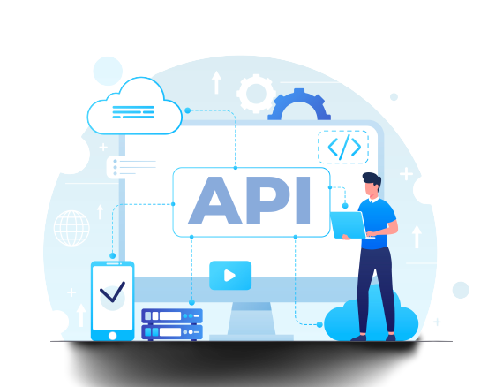
RESTful API design principles
The following are some of the key principles of RESTful API design:
Resources: Everything in a RESTful API is a resource. A resource can be anything, such as a user, a product, or an order.
URIs: Each resource is identified by a unique URI.
HTTP methods: The four HTTP methods (GET, POST, PUT, and DELETE) are used to perform CRUD operations on resources.
Representations: Resources are represented in a variety of formats, such as JSON, XML, and HTML.
Notes:
Understanding RESTful API Design
RESTful APIs are not just a technical term but a bridge that connects various applications and services, making our digital experiences seamless and integrated.
Let’s break down the key concepts:
Resources: Resources represent entities such as users, products, or orders that APIs expose. Think of them as the nouns in our API world.
Uniform Resource Identifiers (URIs): URIs are the addresses for accessing resources. They follow a consistent structure (e.g., https://api.example.com/users/123).
HTTP Methods: These are the verbs that define actions on resources. Common methods include GET (retrieve data), POST (create new data), PUT (update data), and DELETE (remove data).
Representations: Representations define how data is exchanged. Formats like JSON or XML are used to represent resource data.

Slide 7
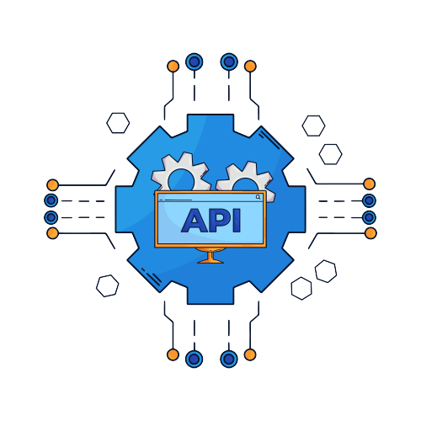
Controller-based API
A controller-based API is a type of API that uses controllers to handle HTTP requests and return responses.
Controllers are classes that inherit from the ControllerBase class and contain methods that are called action methods.
Action methods are used to handle specific types of HTTP requests, such as GET, POST, PUT, and DELETE.
Notes:
lets delve into the intricacies of Controller-based APIs. These APIs play a pivotal role in managing HTTP requests and responses, ensuring a seamless user experience.
Let’s break it down:
Firstly What Are Controller-based APIs?
These APIs employ controllers to handle incoming HTTP requests. Controllers are part of the MVC (Model-View-Controller) architecture. They act as intermediaries, processing requests and returning appropriate responses
let's discuss How Do Controllers Work :
Controllers inherit from the ControllerBase class.They contain action methods tailored to specific HTTP verbs:
GET: Retrieve data (e.g., fetching user profiles).
POST: Create new data (e.g., submitting a form).
PUT: Update existing data (e.g., editing a post).
DELETE: Remove data (e.g., deleting a comment).

Slide 8

Minimal API
Minimal APIs are a simplified approach for building fast HTTP APIs with ASP.NET Core.
You can build fully functioning REST endpoints with minimal code and configuration.
Skip traditional scaffolding and avoid unnecessary controllers by fluently declaring API routes and actions.
Notes:
Minimal APIs are a simplified approach for building fast HTTP APIs with ASP.NET Core.
You can build fully functioning REST endpoints with minimal code and configuration.
By using this approach we can Skip traditional scaffolding and avoid unnecessary controllers by fluently declaring API routes and actions.

Slide 9

API Versioning
Versioning of APIs in ASP.NET Core is a process of creating different versions of an API so that new features can be added without breaking existing clients.
This is done by adding a version number to the API's URL or HTTP header.
Notes:
API Versioning
Versioning of APIs in ASP.NET Core is a process of creating different versions of an API so that new features can be added without breaking existing clients. This is done by adding a version number to the API's URL or HTTP header.

Slide 10
Types of API Versioning
URL-based Versioning: In this approach, the version number is included in the API endpoint URL.For example, /api/v1/customers or /api/v2/customers.
Query Parameter Versioning: Versioning information is passed as a query parameter in the API request. For example, /api/customers?version=1.
Header Versioning: The version number is specified in a custom header in the API request, such as X-API-Version: 1.
Content Negotiation: The version is determined based on the request's Accept header or content negotiation mechanism, where different media types represent different API versions.
Notes:
in this slide we explore four predominant strategies employed by developers globally. there are mainly 4 types of api versioning are available
first one is URL-based Versioning:
In this approach, the version number is seamlessly integrated into the API endpoint URL.
For instance, “/api/v1/customers” or “/api/v2/customers” exemplify how different versions of the API are accessed via distinct URLs.
Next one is Query Parameter Versioning:
Here , versioning information is conveyed as a query parameter within the API request.
An example to illustrate this would be “/api/customers?version=1,” where the version information is explicitly stated as a parameter.
Then Header Versioning :
In this method, the version number finds its place in a custom header within the API request.
For example: “X-API-Version: 1.” This approach ensures that version information remains integral yet separate from the endpoint URL.
finally Content Negotiation:
it is a dynamic mechanism where the version is determined based on the request’s Accept header or content negotiation mechanism.
It allows different media types to represent various API versions effectively.

Slide 11
Swagger and Postman
Swagger and Postman are two tools that can be used to consume APIs.
Swagger is a tool that can be used to generate documentation for APIs. Postman is a tool that can be used to send HTTP requests to APIs
Notes:
here we explore two indispensable tools in the world of APIs: Swagger and Postman.
swagger
Swagger is a set of open-source tools used to design, build, document, and use REST APIs. It's also known as the OpenAPI Specification.
it is primarily used for generating API documentation. It makes APIs easier to understand and use effectively. For visualizing lets imagine
Swagger as a friendly guide that provides clear directions through the API landscape.
Postman:
Postman is a platform for building and using APIs. It has a graphical user interface that allows users to test APIs.Postman is renowned for sending HTTP requests to APIs.
As you can see in the visual, a person interacts with various API elements, symbolizing the ease of using these tools.
Remember, whether you’re documenting APIs or testing them, Swagger and Postman are your trusty companions.

Slide 12
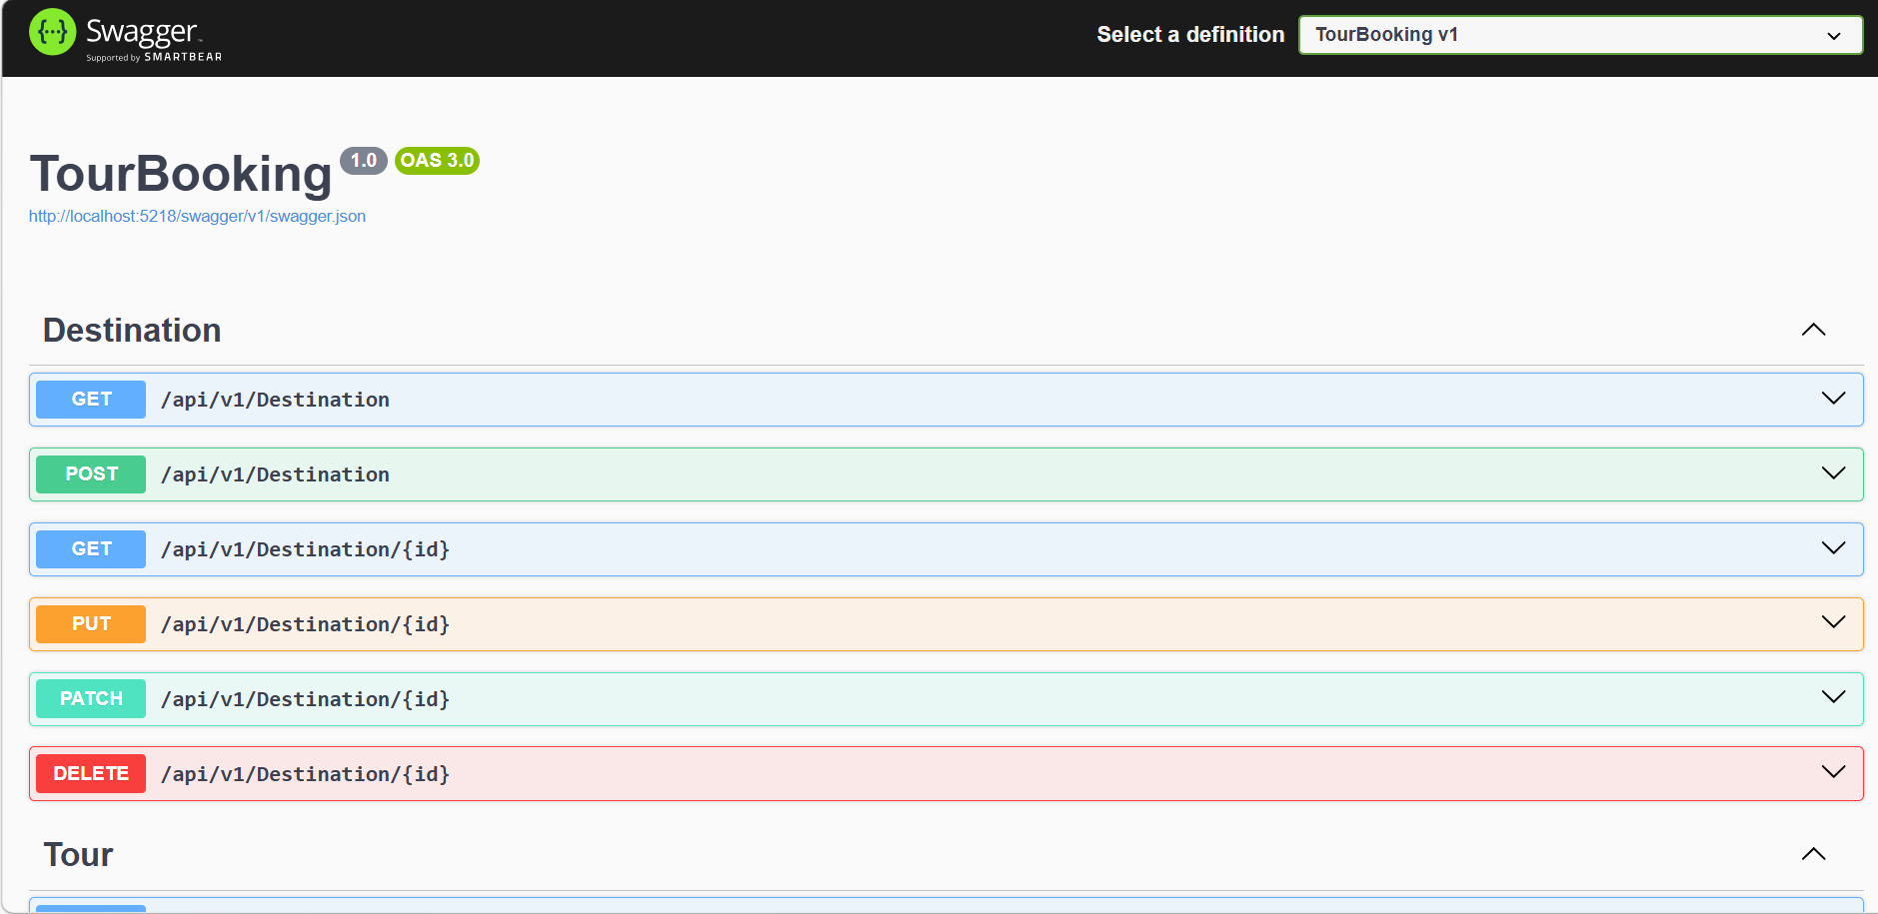
Swagger
Notes:
This is the sample screen of swagger that listing some apis.
Swagger allows you to describe the structure of your APIs so that machines can read them. The ability of APIs to describe their own structure is the root of all awesomeness in Swagger. Why is it so great? Well, by reading your API’s structure, we can automatically build beautiful and interactive API documentation. We can also automatically generate client libraries for your API in many languages and explore other possibilities like automated testing. Swagger does this by asking your API to return a YAML or JSON that contains a detailed description of your entire API. This file is essentially a resource listing of your API which adheres to OpenAPI Specification. The specification asks you to include information like:
What are all the operations that your API supports?
What are your API’s parameters and what does it return?
Does your API need some authorization?
And even fun things like terms, contact information and license to use the API.
You can write a Swagger spec for your API manually, or have it generated automatically from annotations in your source code.

Slide 13
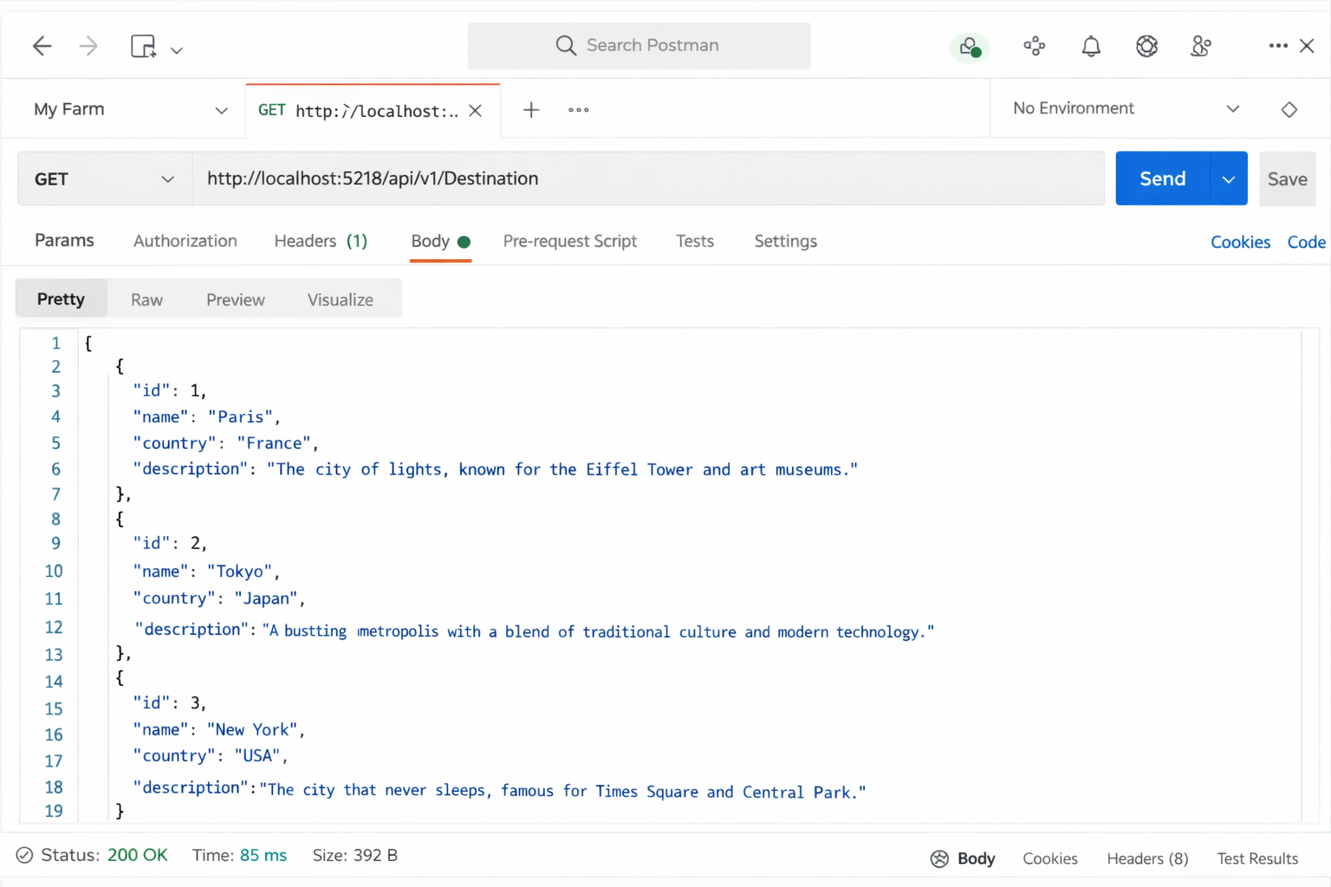
Postman
Notes:
Postman is an API platform for building and using APIs. Postman simplifies each step of the API lifecycle and streamlines collaboration so you can create better APIs—faster.
This is the a sample view of postman.Here we can specify the HTTP method of the api , url , body , headers etc..And it also provide a output window for analysing responses .

Slide 14

Thank you

